Slide 1
Recap
(Wave nature of Light)
In 2-slit experiment, it is impossible to arrange the light in such a way that one can tell which hole the electron went through, and at the same time not disturb the pattern.
Heisenberg proposed, as a general principle, his uncertainty principle, which we can state in terms of our experiment as follows: “It is impossible to design an apparatus to determine which hole the electron passes through, that will not at the same time disturb the electrons enough to destroy the interference pattern.”
If an apparatus is capable of determining which hole the electron goes through, it cannot be so delicate that it does not disturb the pattern in an essential way. No one has ever found (or even thought of) a way around the uncertainty principle. So we must assume that it describes a basic characteristic of nature.

Slide 2
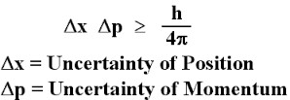
Mathematically we describe the uncertainty principle as the following,

Slide 3
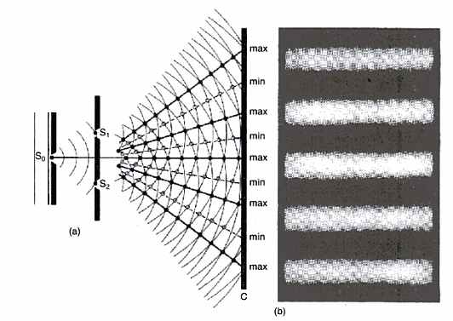
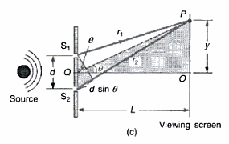
Young’s Double Slit Experiment of Light
The wave nature of light was established by Young’s double slit experiment where the sinusoidal interference pattern of coherence light falling on a screen behind two linear slits of small spacing d, is guided by nλ = d sinθ, where λ is the wavelength of light and θ is the angular position of the appearance of maxima on the interference pattern and n is an integral number.
The path difference of the light from two slits shall be an integral multiple of light wavelength nλ.

Slide 4
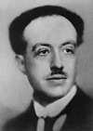
MATTER WAVES
De Broglie
We have seen that light comes in discrete units (photons) with
particle properties (energy and momentum) that are related to the
wave-like properties of frequency and wavelength.
In 1923 Prince Louis de Broglie postulated that ordinary matter can have
wave-like properties, with the wavelength λ related to momentum
p in the same way as for light
de Broglie relation
Planck’s constant
de Broglie wavelength
wavelength depends on momentum, not on the physical size of the particle
Prediction: We should see diffraction and interference
of matter waves

Slide 5
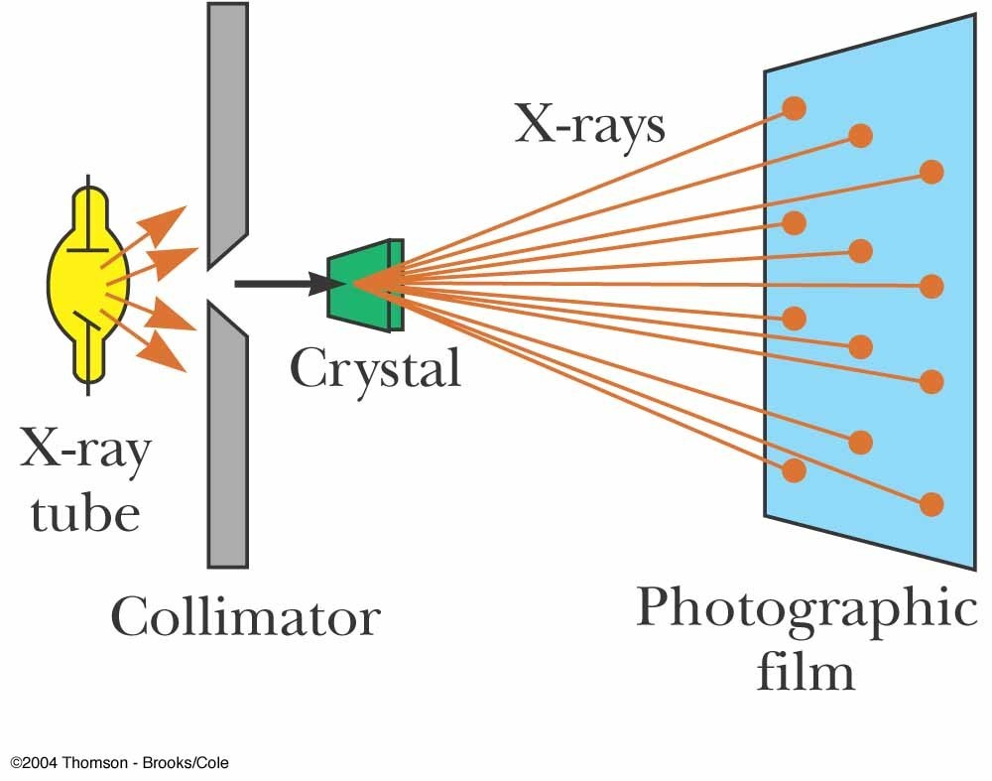
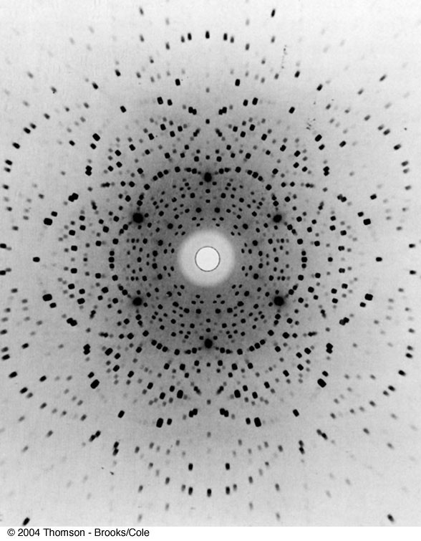
X-rays diffraction:
X-rays are electromagnetic waves with
λ = 10⁻⁸ to 10⁻¹² m = 10 – 0.001 nm

Slide 6
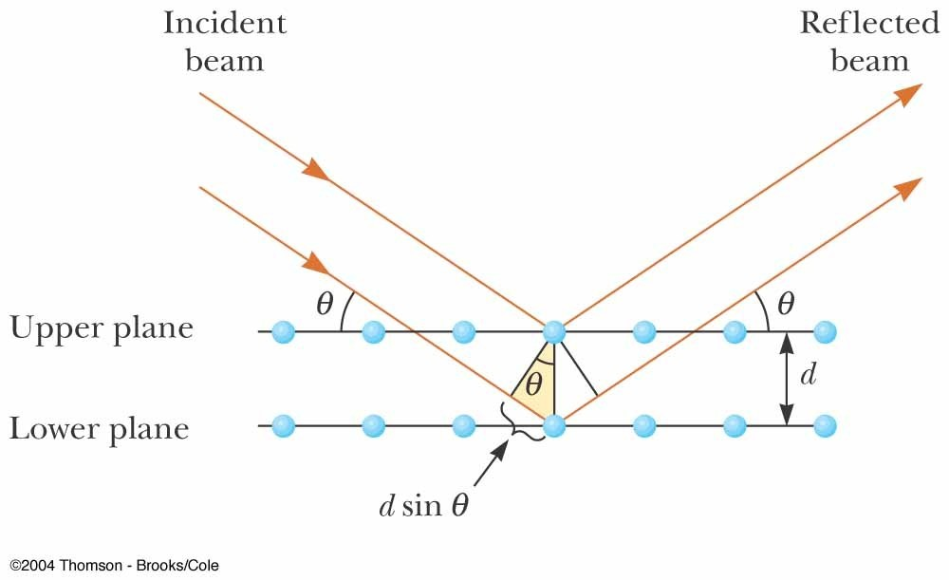
Bragg’s law:
2d sinθ = nλ
If θ and λ are known,
d can be determined

Slide 7
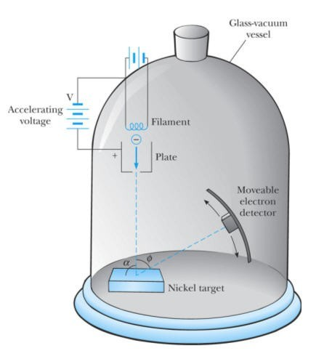
Davisson-Germer experiment:
Electrons were directed onto nickel crystals
Accelerating voltage is used to control electron energy: E = |e|V
The scattering angle and intensity (electron current) are detected .
φ is the scattering angle

Slide 8
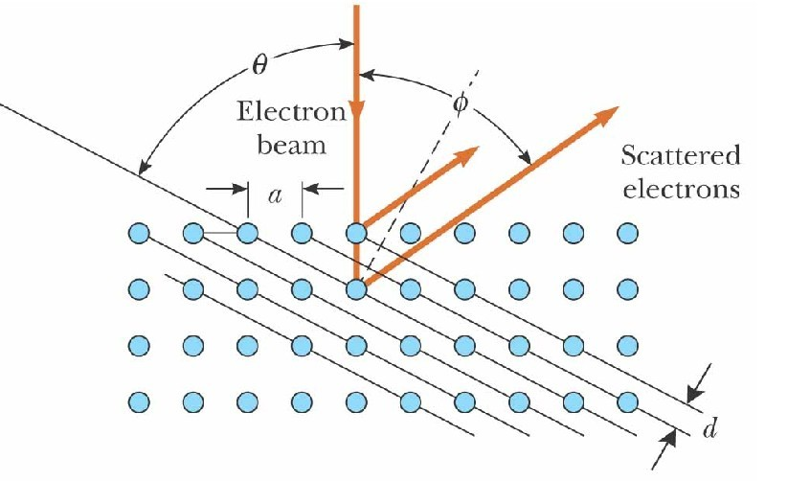
Electron scattering:
From X-ray experiments: d = 0.091 nm
2d sinθ = nλ
For φ = 50° (θ = 65°):
λ = 0.165 nm

Slide 9
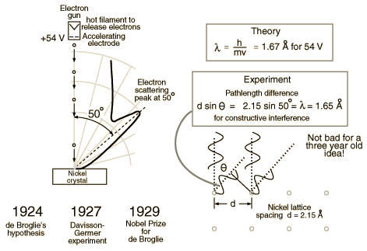
Application of diffraction to
measure atomic spacing
Single crystal Ni target
Proved deBroglie hypothesis that λ=h/p
Davisson-Germer experiment

Slide 10
Proof that λ=h/p
Accelerated electrons have energy eV:
eV= ½ mv² => v = (2Ve/m)^{1/2}
de Broglie said:
λ=h/p=h/(mv)=h/(2mVe)^{1/2}=1.67 Å Davisson-Germer found lattice spacing:
λ=dsinθ=1.65 Å
Excellent agreement between theory and experiment!

Slide 11
Discrete nature of atomic and molecular spectra
Besides failing to explain blackbody radiation, the Compton, photoelectric, and pair production effects and the wave–particle duality, classical physics also fails to account for many other phenomena at the microscopic scale.
Experimental observations reveal that atoms exist as stable, bound systems that have discrete numbers of energy levels. Classical physics, however, states that any such bound system must have a continuum of energy levels.

Slide 12
Rutherford Planetary Model of the Atom
Rutherford considered the atom to consist of electrons orbiting around a positively charged massive center, the nucleus. It was soon recognized that, within the context of classical physics, this model suffers from two serious deficiencies:
atoms are unstable
(b) atoms radiate energy over a continuous range of frequencies.

Slide 13
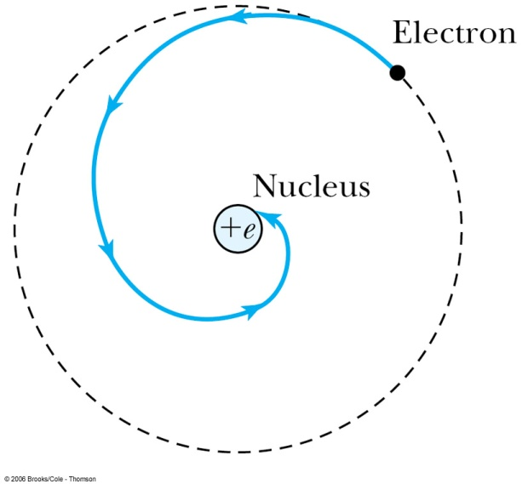
atoms are unstable
Results from the application of Maxwell’s electromagnetic theory to Rutherford’s model: as the electron orbits around the nucleus, it accelerates and hence radiates energy. It must therefore lose energy. The radius of the orbit should then decrease continuously (spiral motion) until the electron collapses onto the nucleus; the typical time for such a collapse is about 10⁻ ⁸s.

Slide 14
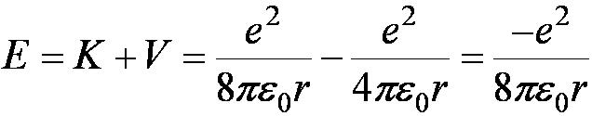
Mathematical Explanation of (a)
Consider an atom as a planetary system.
The Newton’s 2nd Law force of attraction on the electron by the nucleus is:
where v is the tangential velocity of the electron:
The total energy is then:
This is negative, so the system is bound, which is good.

Slide 15
(b) atoms radiate energy over a continuous range of frequencies.
Since the frequency of the radiated energy is the same as the orbiting frequency, and as the electron orbit collapses, its orbiting frequency increases continuously. Thus, the spectrum of the radiation emitted by the atom should be continuous.
These two conclusions completely disagree with experiment, since atoms are stable and radiate energy over discrete frequency ranges.

Slide 16
Bohr Model of the Hydrogen Atom
Combining Rutherford’s planetary model, Planck’s quantum hypothesis, and Einstein’s photon concept, Bohr proposed in 1913 a model that gives an accurate account of the observed spectrum of the hydrogen atom as well as a convincing explanation for its stability.
Bohr assumptions
The electron moves in a circular orbit around the nucleus under the influence of the electrostatic force.
Instead of a continuum of orbits, which are possible in classical mechanics, only a discrete set of circular stable orbits, called stationary states, are allowed. Atoms can exist only in certain stable states with definite energies: E1, E2, E3, etc.
3. The allowed (stationary) orbits correspond to those for which the orbital
angular momentum of the electron is an integer multiple of ħ ( ħ = h/(2π)).
L=n ħ

Slide 17
Bohr assumptions
As long as an electron remains in a stationary orbit, it does not radiate electromagnetic energy. Emission or absorption of radiation can take place only when an electron jumps from one allowed orbit to another. The radiation corresponding to the electron’s transition from an orbit of energy E_{u} to another E_{l} is carried out by a photon of energy
hʋ = E_{u}-E_{l}
So an atom may emit (or absorb) radiation by having the electron jump to a
lower (or higher) orbit.

Slide 18
Bohr Model (Energy levels of Hydrogen Atom)
The angular momentum is:
So the velocity is:
a₀
But:
So:
Solving for r_{n}:
where:
a₀ is called the Bohr radius. It’s the diameter of the Hydrogen atom (in its lowest-energy, or “ground,” state).

Slide 19
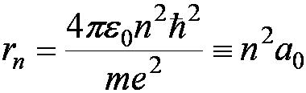
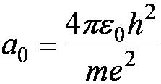


Bohr Radius
The diameter of the hydrogen atom for stationary states is
Where the Bohr radius is given by
The smallest diameter of the hydrogen atom is
n = 1 gives its lowest energy state (called the “ground” state)

Slide 20
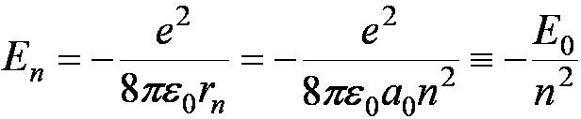
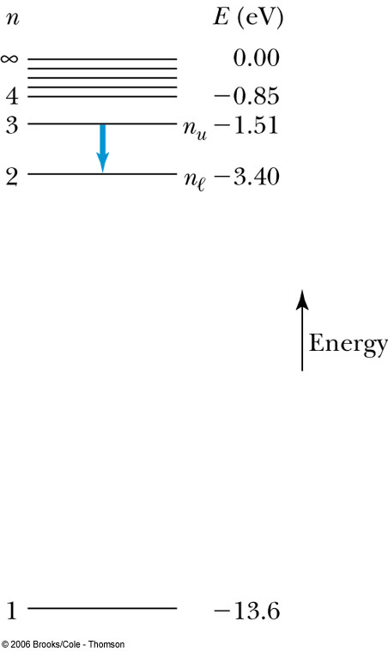

The Hydrogen Atom
The energies of the stationary states where E₀ = 13.6 eV.
Emission of light occurs when the atom is in an excited state and decays to a lower energy state (n_{u} → n_{ℓ}).
where ν is the frequency of a photon.
R∞ is the Rydberg constant.

Slide 21
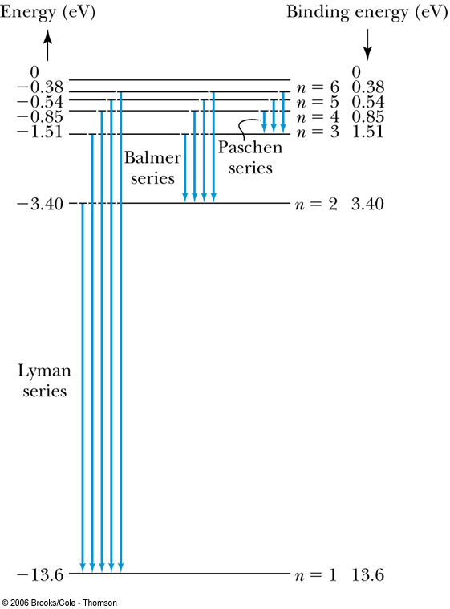
Transitions in the Hydrogen Atom
The atom will remain in the excited state for a short time before emitting a photon and returning to a lower stationary state. All hydrogen atoms exist in n = 1 (invisible).

Slide 22
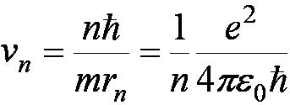
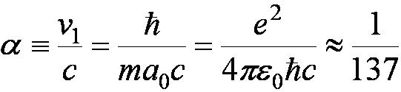
Fine Structure Constant
The electron’s velocity in the Bohr model:
On the ground state,
v₁ = 2.2 × 10⁶ m/s ~ less than 1% of the speed of light.
The ratio of v₁ to c is the fine structure constant.

